Slide 1

Team 3
Азжаргал
Золбоо
Цогтбаяр

Slide 2
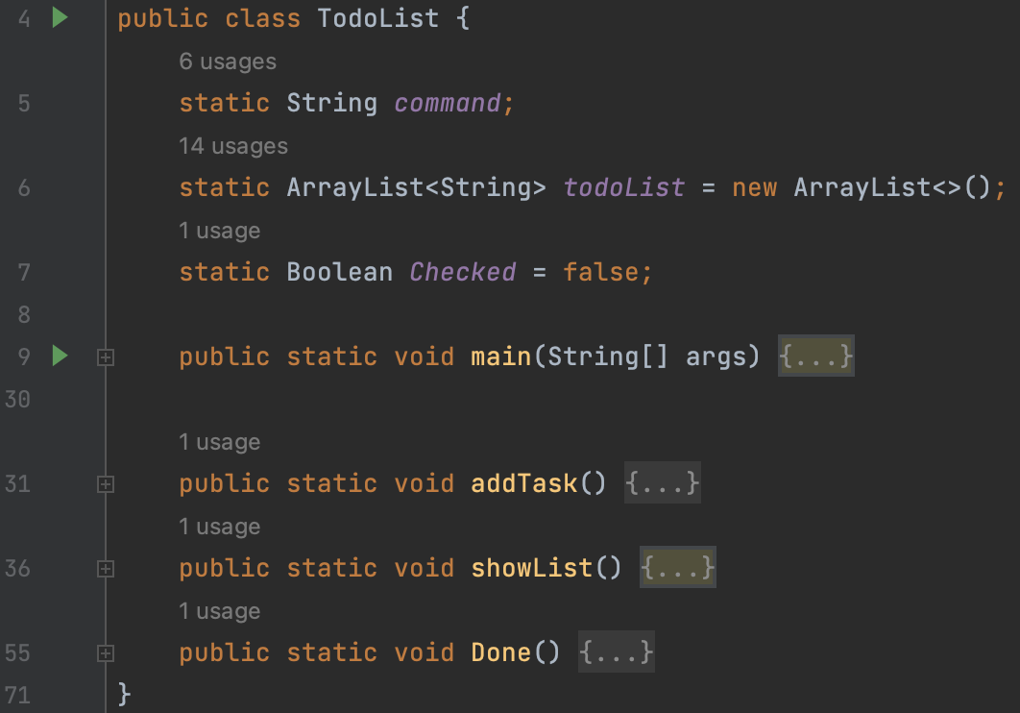
Main
static ArrayList<String> todoList = new ArrayList<>();
Scanner sc = new Scanner(System.in); while (true) { command = sc.nextLine(); if (command.contains("add")) { addTask(); } if (command.contains("list")) { showList(); } if (command.contains("done")) { Done(); }}

Slide 3
Add Task
Regex, limit
String[] itemSplit = command.split((add)); todoList.add(itemSplit[2]); System.out.printf("Created task %d.\n", todoList.size());
Task add Buy milk
input | output
task add Buy milk | Created task 1.

Slide 4
Done Task (Remove)
input | output
task 2 done | ID Description -- --------------- 1 Buy milk 2 Buy egg 3 Bake cake 4 Finish Todo list task 4
input | output
task 2 done | ID Description -- --------------- 1 Buy milk 2 Bake cake 3 Finish Todo list task 3
char[] number = command.toCharArray(); StringBuilder n = new StringBuilder(); for (char id : number) { if (Character.isDigit(id)) { n.append(id); int index = Integer.parseInt(String.valueOf(n)); if ((index - 1) < 0 || index > todoList.size()) System.out.println(" Wrong ID " + todoList.size()); else todoList.remove(index - 1);}}
input | output
task 2 done | ID Description -- --------------- 1 Buy milk 2 Buy egg 3 Bake cake 4 Finish Todo list task 4

Slide 5
Show all task
input | output
task list | ID Description -- --------------- 1 Buy milk 2 Buy egg 3 Bake cake 4 Finish Todo list task 4
for (int j = 0; j < 2; j++) { if (todoList.contains("done")) { for (int i = 0; i < todoList.size(); i++) { if (todoList.get(i).equals("done")) todoList.remove(i); }}} for (int j = 0; j < todoList.size(); j++) { System.out.println(todoList.indexOf(todoList.get(j)) + 1 + " " + todoList.get(j));
} System.out.println("task " + todoList.size());

